Slide 1
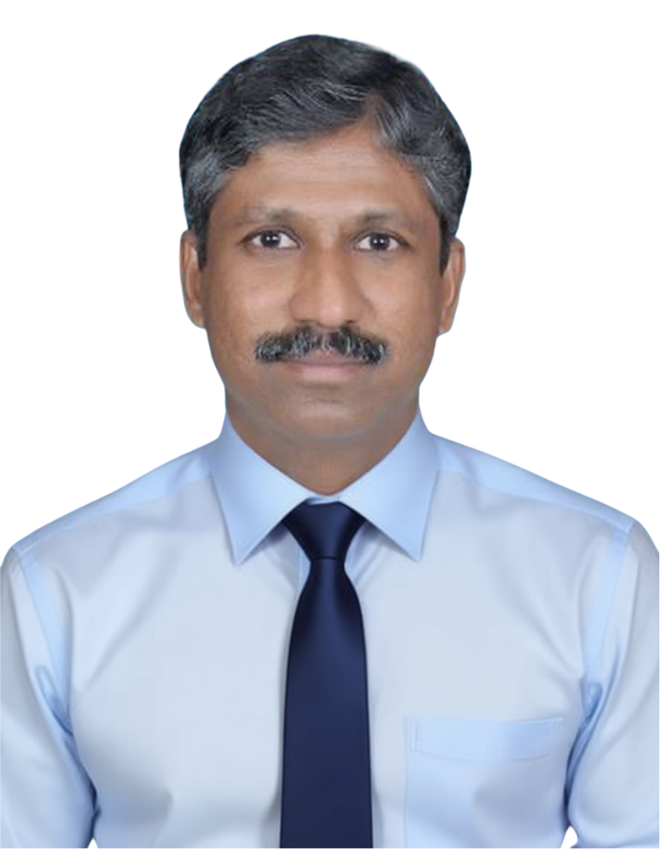

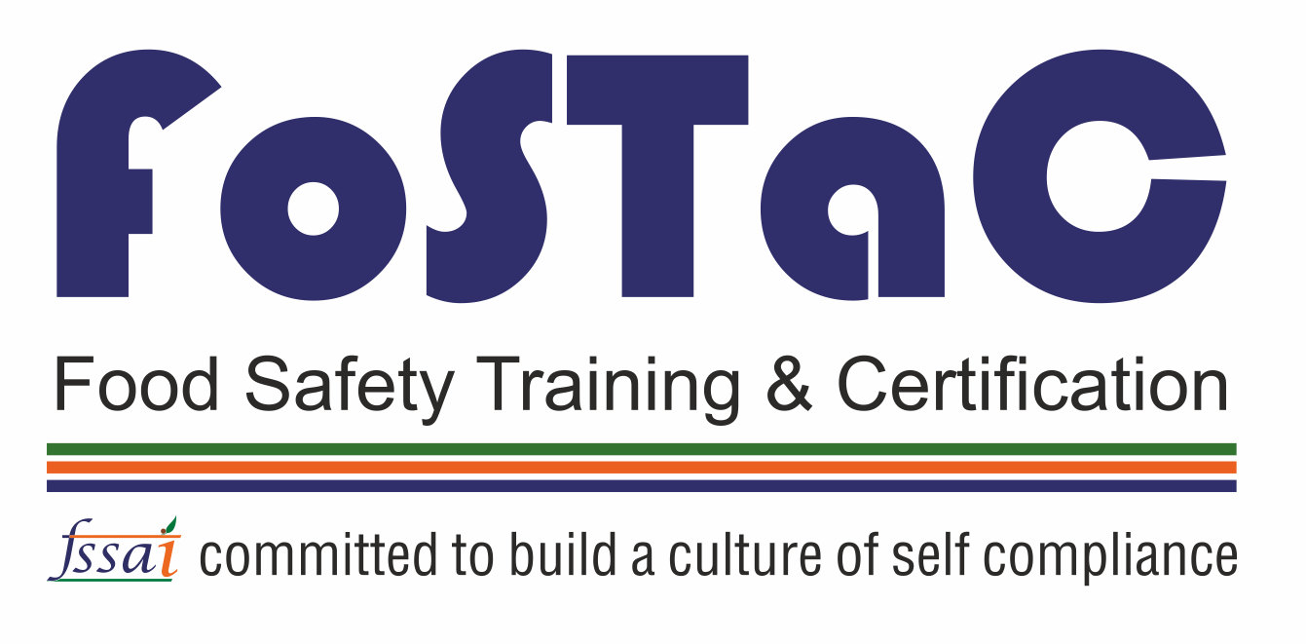





THAMMAIAH N D,
Managing Director,
Swasthya Food Consulting
M. Tech in Dairy Science with 22 years of experience
Worked in Saudi Arabia for 10 years in Companies like Almarai & NADEC
Started Swasthya Food Consulting in 2022
Top 100 Performing FoSTaC Trainer in India and No. 1 Performing Trainer for Milk Products
Quality Council of India (QCI) approved Food Safety Consultant
APEDA approved FSMS Implementation Agency
BRCGS Approved Training Partner (ATP) – Food Safety
BRCGS approved Food Safety Consultant
Conducted 1200+ Quality & Food Safety Trainings
Conducted 1200+ First-party & Second-Party Audits
Working with more than 135 food companies including Hotels across India

Slide 2

Company Description
COMPANY PROFILE
Swasthya Food Consulting is the dream project of a food industry expert with more than 21 years of experience. This proprietary firm was established in 2022.
Vision
SWASTHYA IN NUMBERS
OUR CORE SERVICES
To provide world class consultation and training in food industry.
279+
Trainings Conducted
FSSAI Regulatory Support
6863 +
Participants Trained
ISO / FSMS Consultancy
2763 +
Hours of Training
Technical Trainings
THAMMAIAH N D
Managing Director
Swasthya Food Consulting
FoSTaC
160 +
FoSTaC Trainings Conducted
Audits
96.7 %
Participants Rated Excellent
Other Technical Services
+91-8105787342
Swasthya Food Consulting
GSTIN – 29AJFPD0474P1ZV
#102, Bluejay Atmosphere-2, Karihobanahalli
Andrahalli Main Road, Bengaluru, 560073
thammaiah.nd@gmail.com
thammaiah.nd@swasthyafoodconsulting.com
https://swasthyafoodconsulting.com/

